Slide 1

Title: Whatsapp Chat Sentiment Analysis
Maulana Azad
National Institute of Technology
Bhopal, India, 462003
SEMESTER: VI
Under the guidance of
Dr. Deepak Singh Tomar
(Associate Professor)
Department of Computer Science and Engineering
PRESENTED BY:
Mridul Karan 191112273
Himanshu Kumar 191112248
Pawan Patel 191112280
Priyanshu Mangal 191112250

Slide 2
Literature Reviewed
Students spent 8 hours per day using WhatsApp and remained online almost 16 hours a day
Suppala K, Rao N developed the sentiment analysis using Naive Bayes Classifier. Here, they tried to predict the emotion of the sentence whether it is positive, negative or neutral. [1]
Sheng et al. found rumors based on consumer opinion was discussed. They discussed the sentimental characteristic of the comment and along with that they also discussed the huge amount of information on comments. [2]
Fu et al. quality improvement in word embedding can be reflected in the sentiment classifier’s accuracy using the sentiment lexicon. Combining the word embedding and sentiment embedding makes the representation of the word more accurate [3]
[1] Suppala K, Rao N (2019) Sentiment analysis using naïve bayes classifier. Int J Innov Technol Explor Eng 8(8):246–269
[2] Lv S, Zhang H, He H, Chen B (2020) MicroblogRumor detection based on comment sentiment and CNN-LSTM. J Artif Intell China.
[3] Xianghua Fu, Yang J, Li J, Fang M, Wang H (2018) Lexicon-enhanced LSTM with attention for general sentiment analysis. IEEE Access.

Slide 3



Project analysis slide 2
Project Analysis
Libraries
Emojis Cheat Sheet
😂
PROJECT
Technology Used
Strengths
System Requirement
Conclusion

Slide 4
Project analysis slide 3
Project Analysis
regex(re)
pandas
matlotlib and
seaborn
emoji
wordcloud, datetime
to extract and manipulate strings based on specific patterns.
for analysis and data manipulation.
for visualization..
to deal with emojis
for the most used words and for datetime manipulation.

Slide 5
Project analysis slide 6
Project Analysis
Technology Used :
It is an interpreted, high-level general-purpose programming language. Created by Guido Van Rossum and first released in 1991. Its language constructs and objects-oriented approach aim to help programmer with clear
It turns data scripts into shareable web apps in minutes. It’s all Python, open-source, and free! And once the app is created it can also be deployed on the cloud platform.
NLTK is a leading platform for building Python programs to work with human language data. It provides easy-to-use interfaces to over 50 corpora and lexical resources
. .
Streamlit
Python
NLTK

Slide 6
Project analysis slide 4
Project Analysis
Tasks:
Active Users,
Frequency of users with most media, messages
.
Retrieving the data from users
Preprocessing the raw data and loading the data frames
Most Used Emojis, most active days an hours and months
Explanatory Data Analysis
Loading the required libraries
t.
Visualization
Of the classified data

Slide 7
Project analysis slide 8
Project Analysis
Strength
It is very efficient as we are dealing with huge data.
It produces a compact analysis of the given data with various mode of presentation.
It can be used in forensics and targeted advertisement

Slide 8
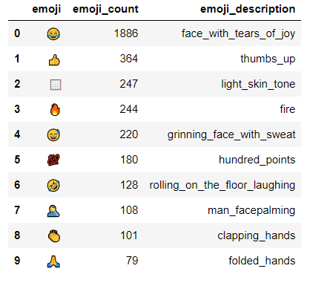
Project analysis slide 5
Project Analysis
here is how the top10emojis dataset looks like!

Slide 9
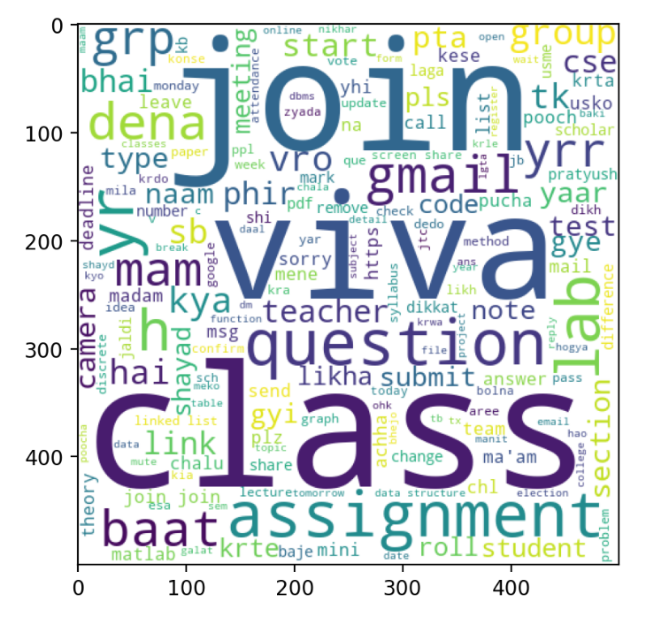
Project analysis slide 5
Project Analysis

Slide 10
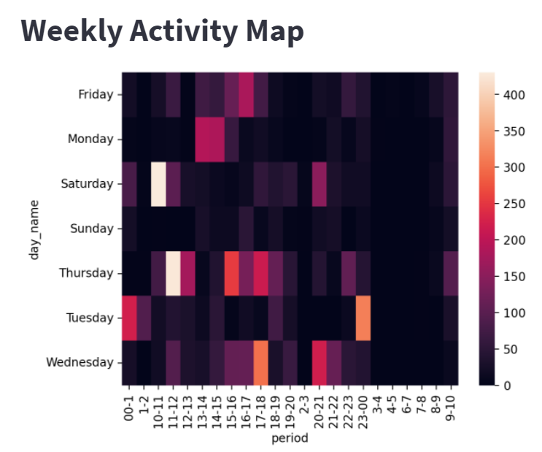
Project analysis slide 5
Project Analysis

Slide 11
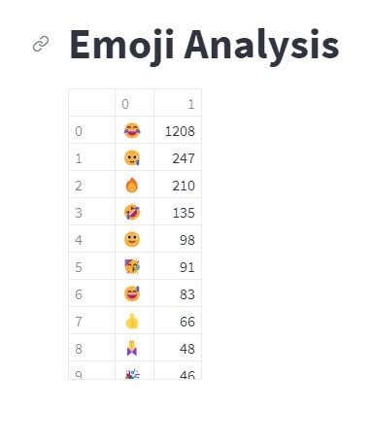
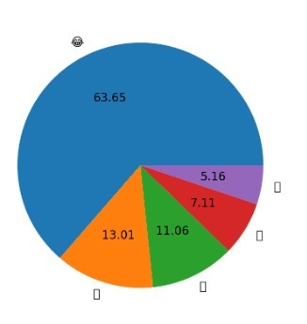
Project analysis slide 10
Project Analysis

Slide 12
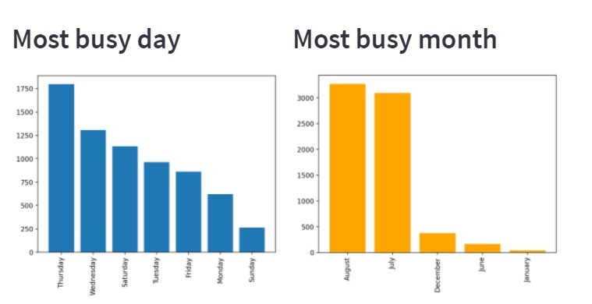
Project analysis slide 10
Project Analysis

Slide 13
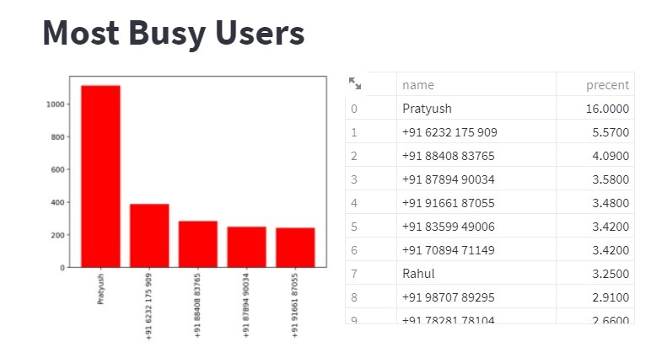
Project analysis slide 10
Project Analysis

Slide 14
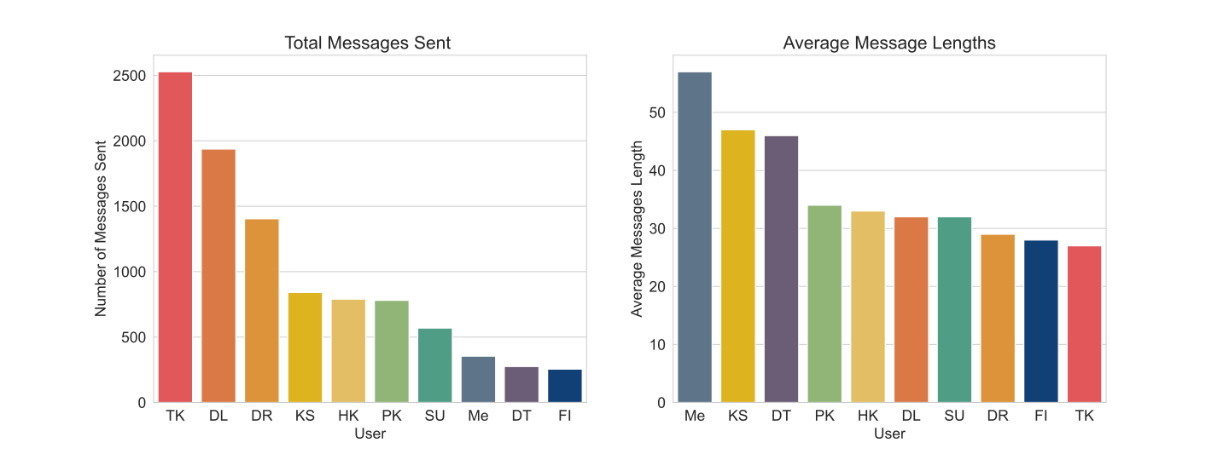
Project analysis slide 10
Project Analysis
Some interesting results
For chat analysis, it can be said that the capabilities of the WhatsApp application and the power of the python programming language in implementing whatever network data analysis intended, cannot be overemphasized.
This work was able to discuss the WhatsApp application and its libraries, to create an analysis of a WhatsApp group chat and visually represent the top 10 and top 20 users in the chat groups.
The system was done with python, and the python libraries that were implemented includes, NumPy, Pandas, Matplotlib and Seaborn. At the end of the work expected results were obtained and the analysis was able to show the level of participation of the various individuals on the given WhatsApp group.

Slide 15
Project Analysis
Sentiment Analysis Flowchart
Data Pre-processing
Lexical Analysis
Word-Embedding, tokenization, removal of Stop-Words
Model Implementation
Naive Bayes Model
Random Forest Model
Model Training and Testing
Train Data
Test Data
Long Term Short Memory (LSTM)
Deployment of Models
Pickle Library
Result on chat data-frame

Slide 16
NLP Processing
Lexical Analysis
Text is broken in tokens.
Mapping directory is created which maps each word with some unique index.
Syntactic and Semantic Analysis
It checks if the words are grammatically correct or incorrect by converting the words to their root words.
Stemming and Lemmatization
Discourse Integration
Analyse upcoming sentences or words in the paragraph.
Analyse the presence of immediate sentences or words.

Slide 17
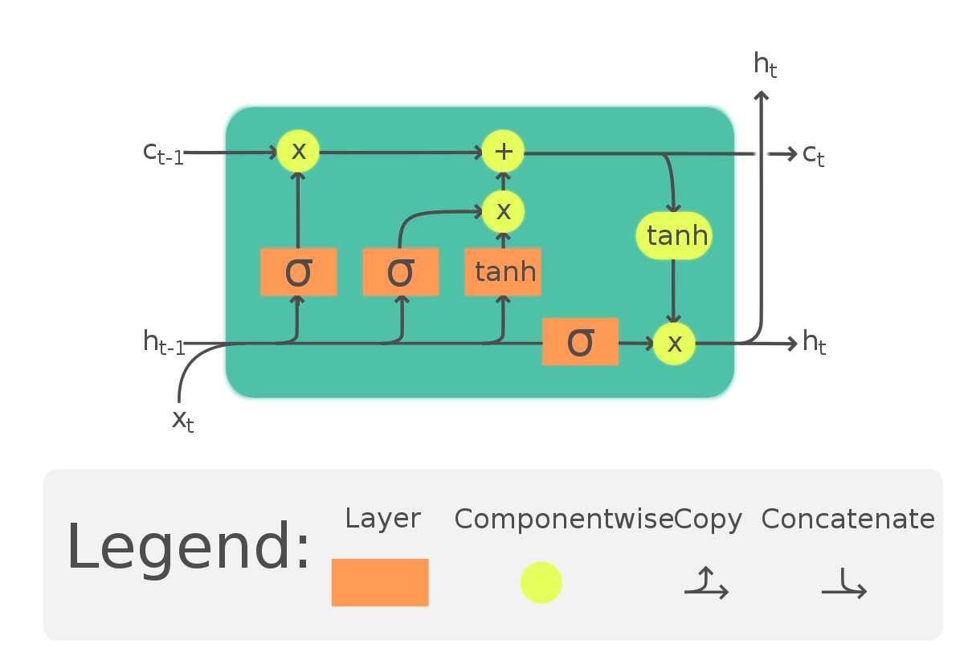
L S T M
Information is added/removed to the memory cells using valves.
The memory cells carry the information from one epoch to another.
The input for a LSTM layer is fed as input (at current time instance) and the output of hidden layer (previous time instance) and these pass-through valves and activation functions before reaching output.

Slide 18
Statistical Analysis of LSTM model
Optimizer Function | Loss Function | Epoch | Accuracy | Loss
rmsprop | mse | 10 | 0.8820 | 0.0317
rmsprop | mse | 12 | 0.8875 | 0.0313
rmsprop | mse | 15 | 0.8905 | 0.0312
rmsprop | mse | 17 | 0.8815 | 0.0349
adam | mse | 10 | 0.8915 | 0.0303
adam | mse | 12 | 0.9020 | 0.0279
adam | mse | 15 | 0.8980 | 0.0291
adam | mse | 17 | 0.8972 | 0.0298
STATISTICAL ANALYSIS OF LSTM MODEL

Slide 19
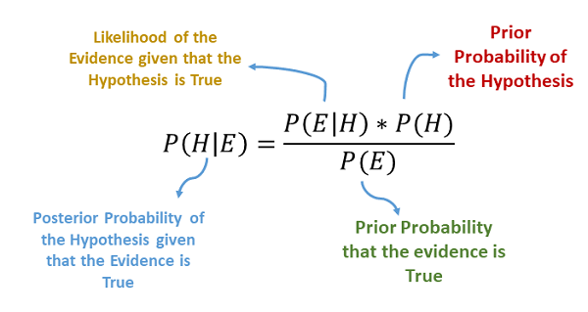
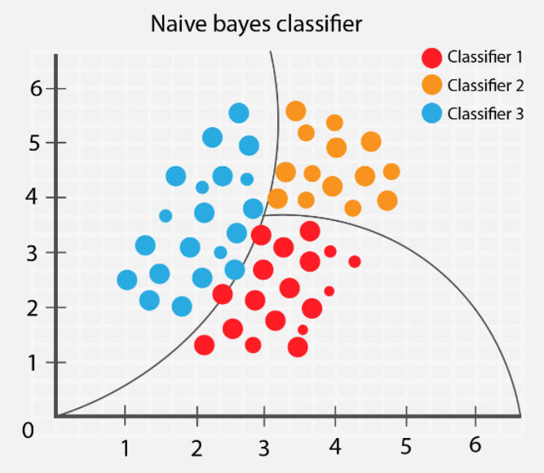
Multinomial Naïve Bayes Classifier
Works on a ‘probabilistic model’.
Assume that each feature is conditionally independent with each other.
It uses multinomial distribution and works on discrete values.
It is much faster than other algorithms.
It is highly scalable.
Tfidf | CountVectorizer
69.85% | 79.75%

Slide 20

Random Forest Model
Random Forest is simply called a collection of trees and each tree is different from one another.
It constructs multiple decision trees and finally merges them together to gain absolute and stable value, which is mainly used at the time of training and outputting the class.
The data for each tree is selected using a method called bagging which selects a random set of data points from the data set for each tree. The data selected can be used again (with w.r.t to placement) or kept aside (without replacement). Each tree randomly pick the feature on the subset of data provided. This randomness provides the possibility of finding the feature importance and combine to give features of maximum importance.

Slide 21
Conclusion
It is noted that LSTM model performs better on Chat English dataset with an accuracy of around 89%.
Naïve Bayes performs faster epochs (iterations) that other models and Multinomial Naïve Bayes performs better computation than Gaussian Naïve Bayes with an accuracy of around 78%.
Random forest model helps in reducing overfitting and input dimensions complexity and thus the accuracy results in bound of 88%.

Slide 22
Thank You

